Slide 1



Slide 2










Slide 3
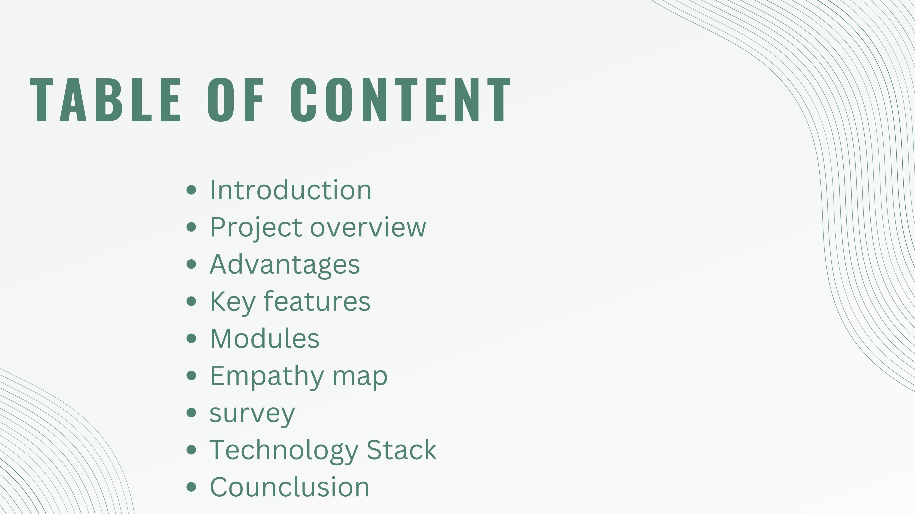

Slide 4

INTRODUCTION
This project revolves around the development of an application using the dynamic MERN stack, tailored to the specific needs of the Airline Reservation System. This system is poised to transform the way flight tickets are booked and organized for
airlines. Acting as a central hub, it empowers customers to seamlessly explore available flights, reserve seats, and oversee their travel plans. Simultaneously, airline
administrators gain the ability to efficiently manage flight schedules, monitor seat availability, and conduct streamlined ticketing operations. Through the synergy of the MERN stack and the intricacies of the airline industry, our project aims to create a powerful and user-friendly platform
that enhances the travel experience for both customers and administrators alike
PROJECT OVERVIEW!

Slide 5
Our project involves the creation of a comprehensive Airline Reservation System utilizing the versatile MERN stack (MongoDB, Express.js, React, Node.js). This innovative application aims to streamline the process of booking and managing flight tickets for airlines, providing a user-centric experience for travelers and efficient tools for airline administrators.

Slide 6
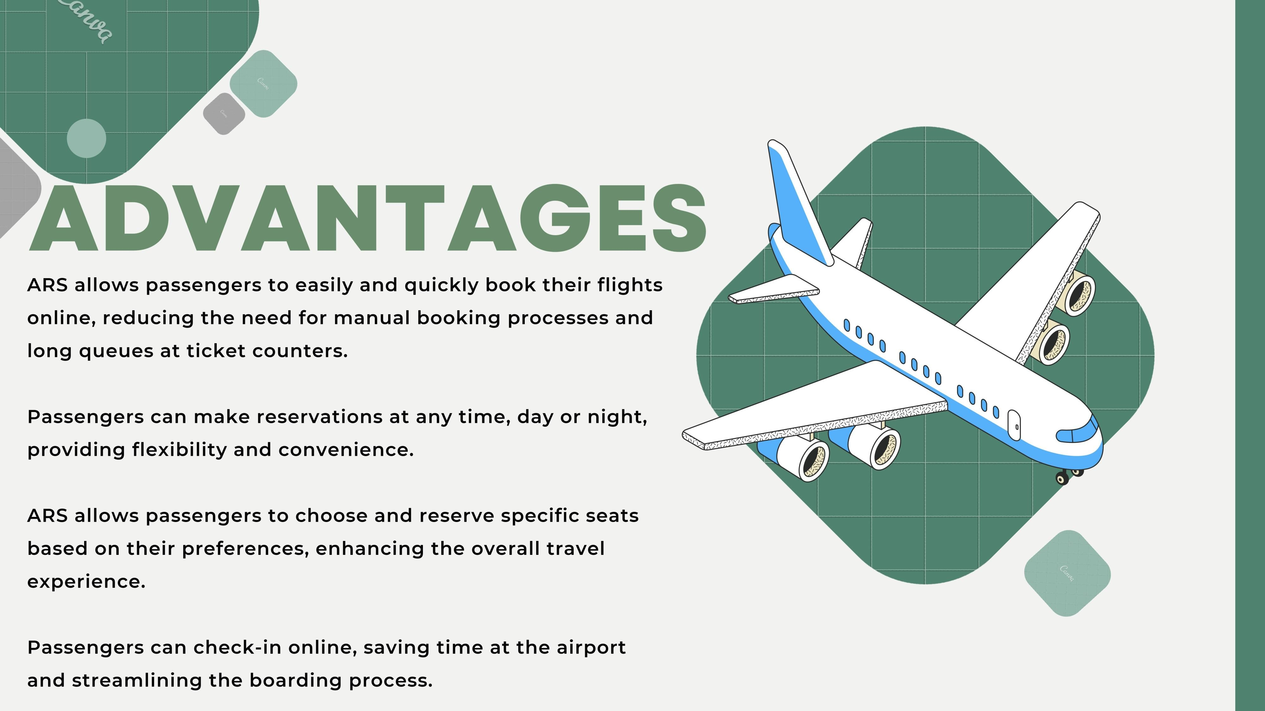

Slide 7





























Slide 8
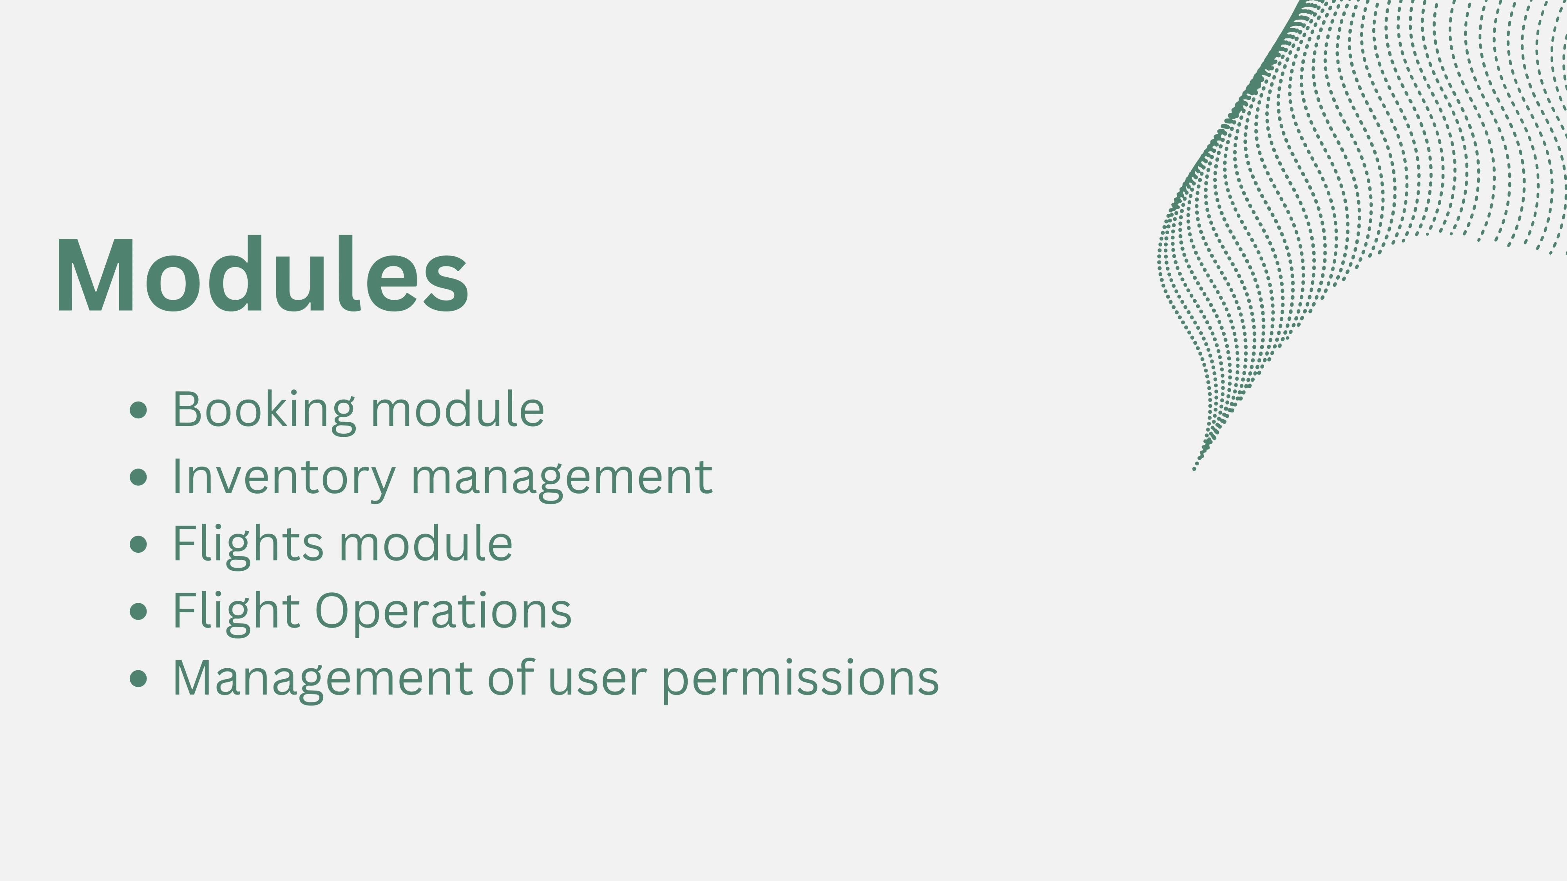

Slide 9
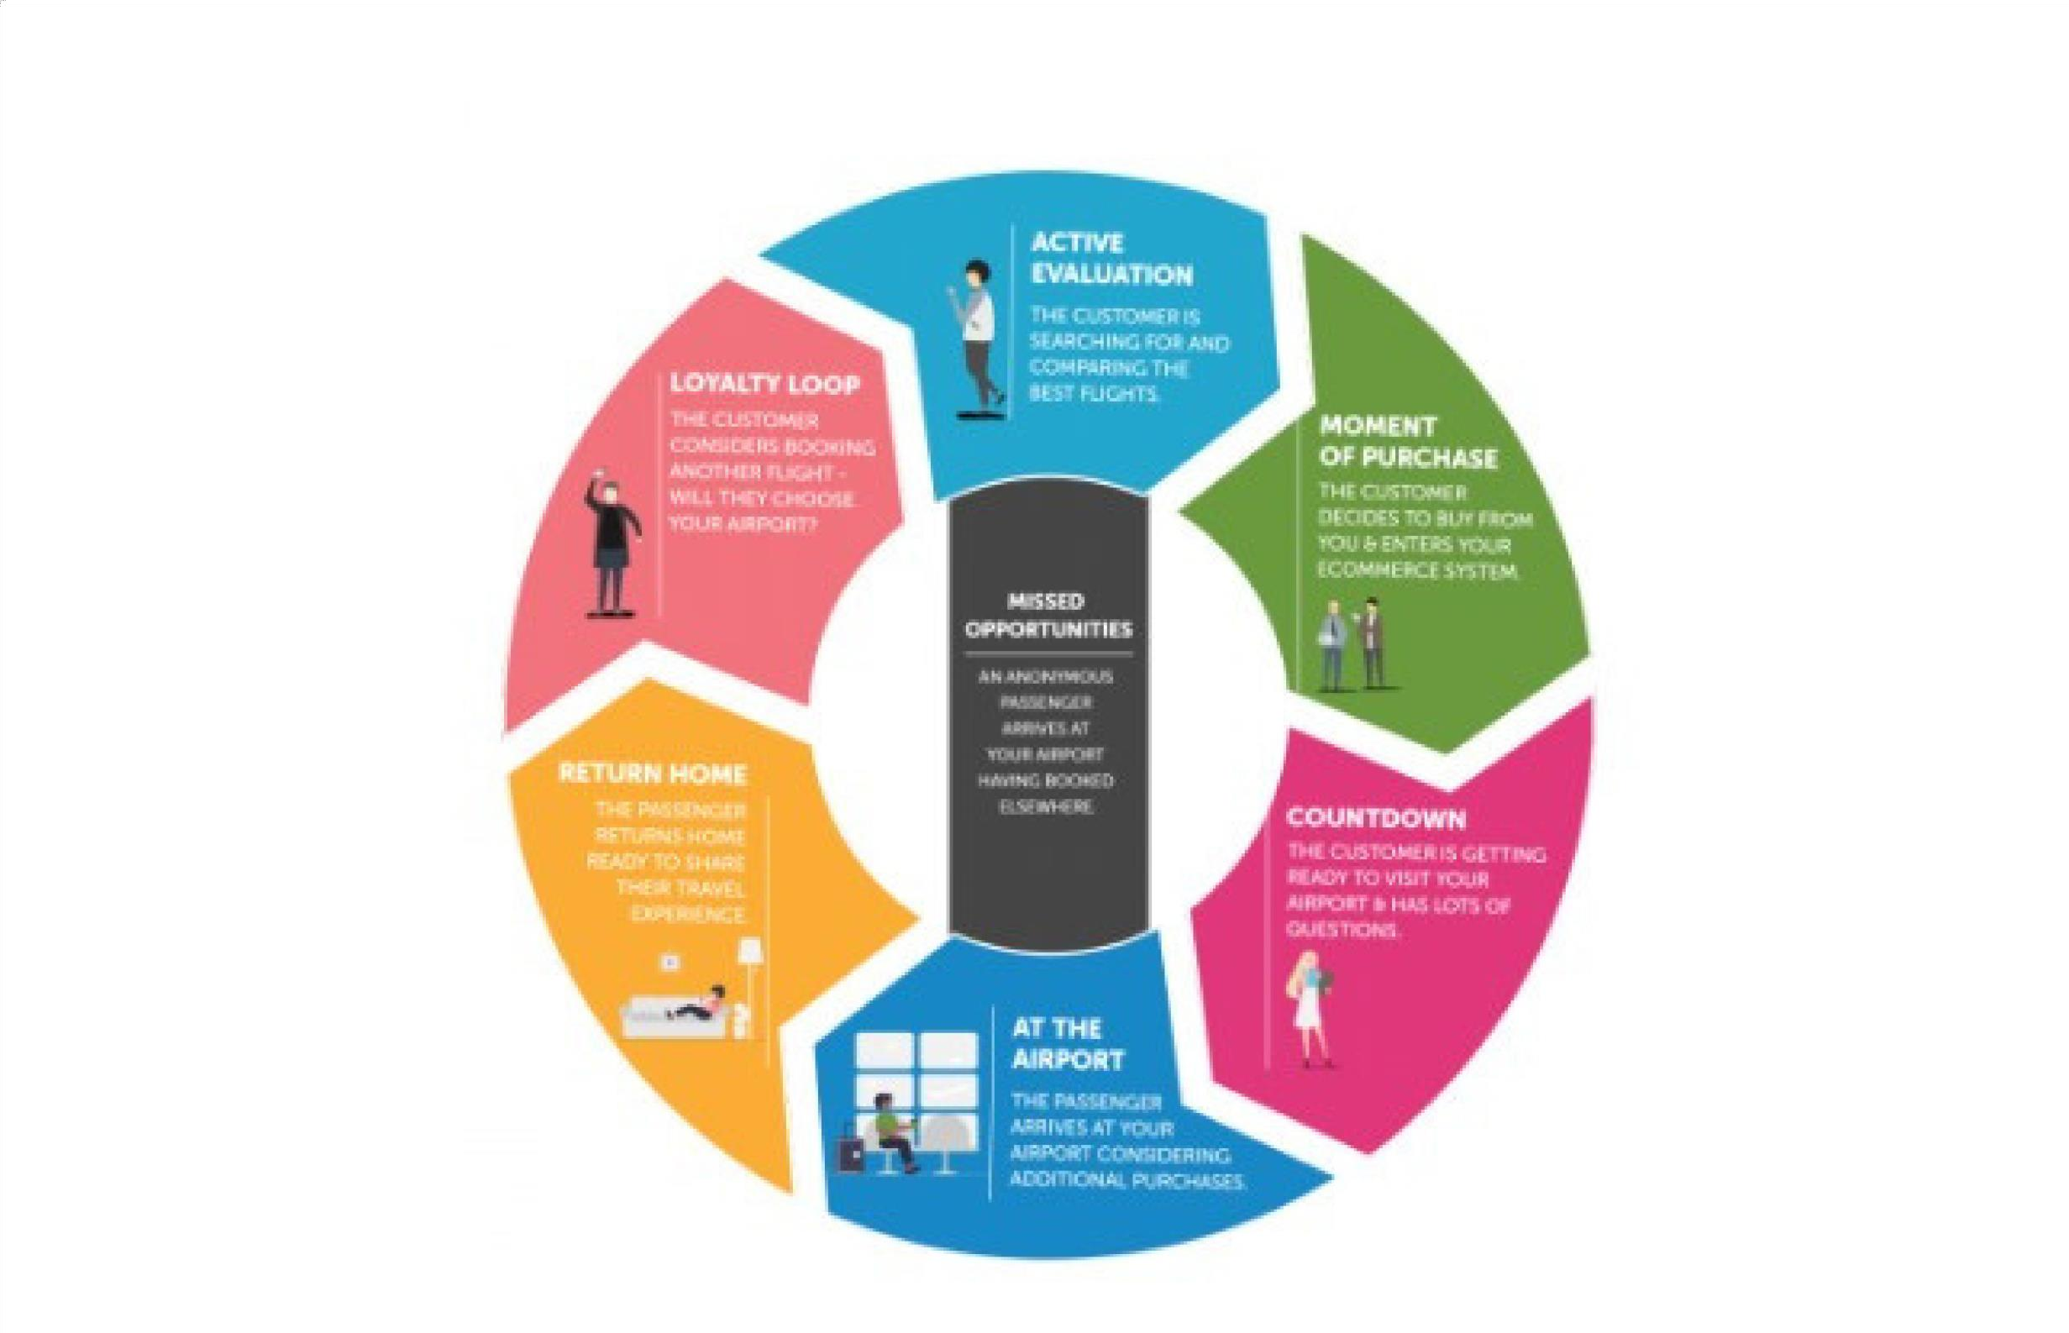
EMPATHY MAP

Slide 10

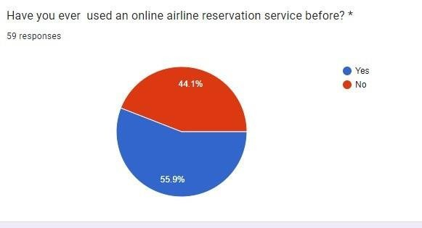
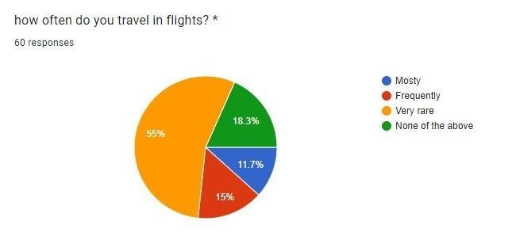
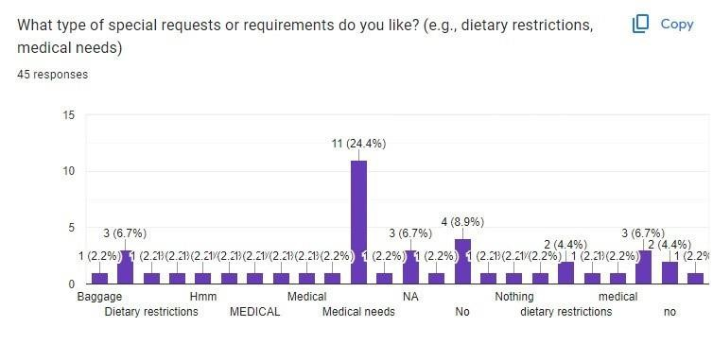
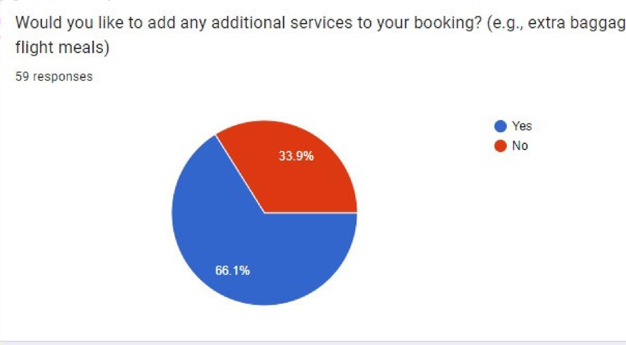

Slide 11







TECHNOLOGY
Front-end: React Redux
Router Back-end: Node.js
Express.js
MongoDB Mongoose
STACK

Slide 12


CONCLUSION
In conclusion, the airline reservation system was successfully designed and implemented with the intension to limit manual operations. This system is user friendly and very much
flexible to non-programmers. It is also tested for maximum accuracy and quality validation. During this project designing, we have accomplished all the tasks and objectives to meet the organizational needs. The system will be used in searching, retrieving and generating
processed information for the concerned request. With this proposed system are reduced errors due to human intervention and conveniently maintains any modifications to the
flight and cancellations in the reservations made at any point of time. It not only provides flight details but also creates a platform to book tickets online, cancels or modifies ticket timings or dates and even informs about the number of people available on board and

Slide 13






